Slide 1

P peline
The Data
Information Visualization
© Jennifer Mankoff
The Data Pipeline; HCII; Spring 2014
Slides cribbed from Marti Hearst http://courses.ischool.berkeley.edu/i247/f05/ (slides 2-10, 16, 19-21, 23, 25-37); Jian Huang, based on a tutorial by Daniel Kiem (slides 39-58); Beomjin Kin (11-14, 17-18)

Slide 2
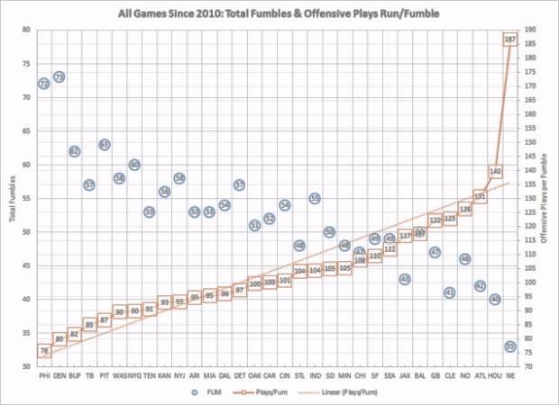
What is wrong with this visualization?
http://regressing.deadspin.com/why-those-statistics-about-the-patriots-fumbles-are-mos-1681805710
Notes:
“One can CLEARLY SEE the Patriots, visually, are off the chart. There is no other team even close to being near to their rate of 187 offensive plays (passes+rushes+sacks) per fumble. The league average is 105 plays/fumble. Most teams are within 21 plays of that number.”
To put it another way, imagine four men standing side-by-side, and three of them range from 6-foot-1 to 6-foot-4; the fourth is 6-foot-6. The tallest man is tall no matter how you frame the men, but if you turn all four into lines on a chart, and start the chart at the shortest man's eyebrows, it's going to paint a certain image of the actual difference in heights.
Note that this is an ongoing debate – worth reading the whole article as well as responses at sharperfootball.com…

Slide 3
Goals for today
Review Quiz 2
Add one more graph to last week’s discussion -- scatterplots
Talk about Information Visualization
Practice Information Visualization
Talk about Byte 3

Slide 4
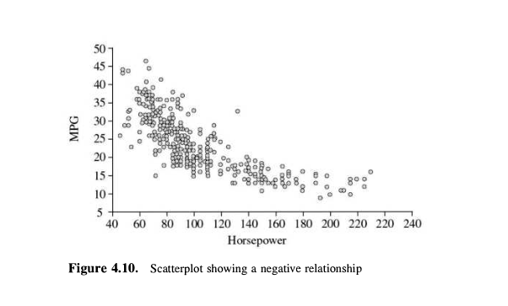
Scatter Plots and Correlation

Slide 5
Scatter Plots and Correlation
A scatter plot & correlation analysis are measures of association (linear relationship) between two variables
These variables change together
Usually scale (interval or ratio) variables

Slide 6
What is “Linear”?
Remember this:
Y=mX+B?
m (slope)
B (intercept)
Adapted from: http://www.sjsu.edu/people/steven.macramalla/courses/stats95/s1/lecture 10
Notes:
A slope of 2 means that every 1-unit change in X yields a 2-unit change in Y.

Slide 7
Scatter Plot Examples
Linear relationships
Curvilinear relationships
y
y
x
x
y
y
x
x
Adapted from http://www.fordham.edu/economics/Vinod/correl-regr.ppt

Slide 8
Scatter Plot Examples
(continued)
Strong relationships
Weak relationships
y
y
x
x
y
y
x
x
Adapted from http://www.fordham.edu/economics/Vinod/correl-regr.ppt

Slide 9
Scatter Plot Examples
(continued)
No relationship
y
x
y
x
Adapted from http://www.fordham.edu/economics/Vinod/correl-regr.ppt

Slide 10
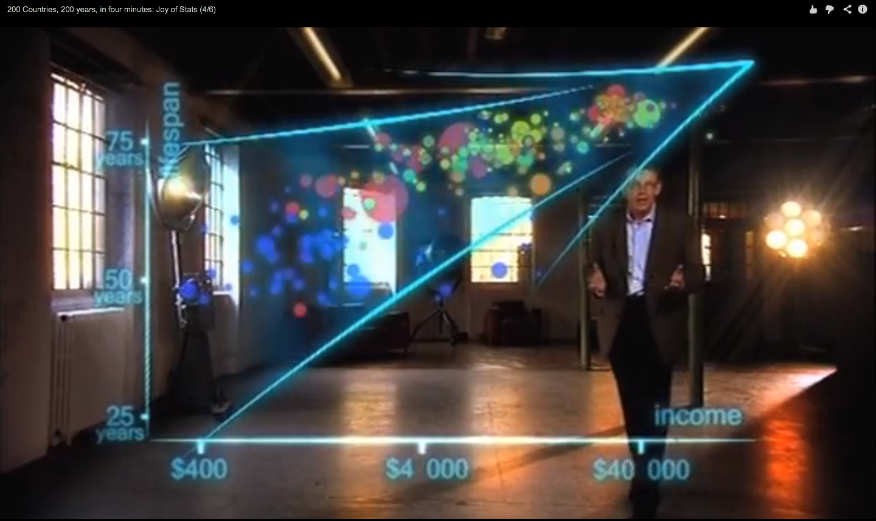
Hans Rosling on Health & Wealth
http://www.youtube.com/watch?v=ahp7QhbB8G4

Slide 11
What is Information Visualization?
Visualize: to form a mental image or vision of …
Visualize: to imagine or remember as if actually seeing.
American Heritage dictionary, Concise Oxford dictionary

Slide 12
What is Information Visualization?
The depiction of information using spatial or graphical representations, to facilitate comparison, pattern recognition, change detection, and other cognitive skills by making use of the visual system (Hearst 03).
“that which gives to the viewer the greatest number of ideas in the shortest time with the least ink in the smallest space.” --Edward R. Tufte
Further Reading: http://fellinlovewithdata.com/guides/7-classic-foundational-vis-papers
Notes:
To help:
Explore
Calculate
Communicate
Decorate

Slide 13
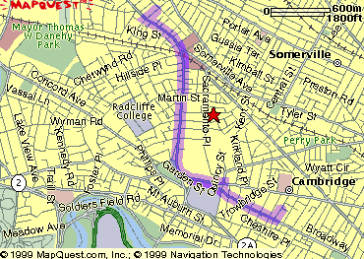
The Power of Visualization
1. Start out going Southwest on ELLSWORTH AVE
Towards BROADWAY by turning right.
2: Turn RIGHT onto BROADWAY.
3. Turn RIGHT onto QUINCY ST.
4. Turn LEFT onto CAMBRIDGE ST.
5. Turn SLIGHT RIGHT onto MASSACHUSETTS AVE.
6. Turn RIGHT onto RUSSELL ST.

Slide 14
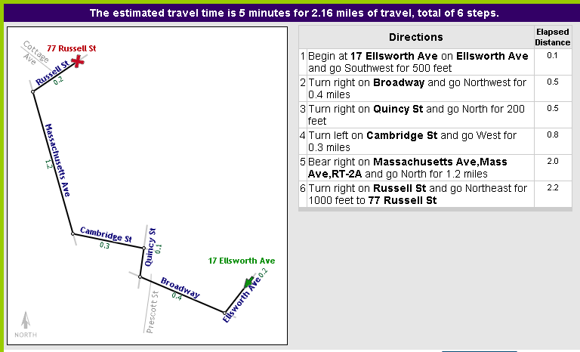
The Power of Visualization
Line drive tool by Maneesh Agrawala http://graphics.stanford.edu/~maneesh/

Slide 15
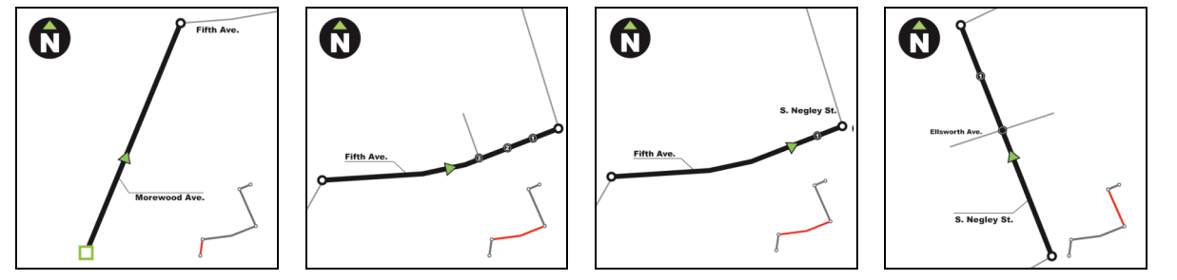
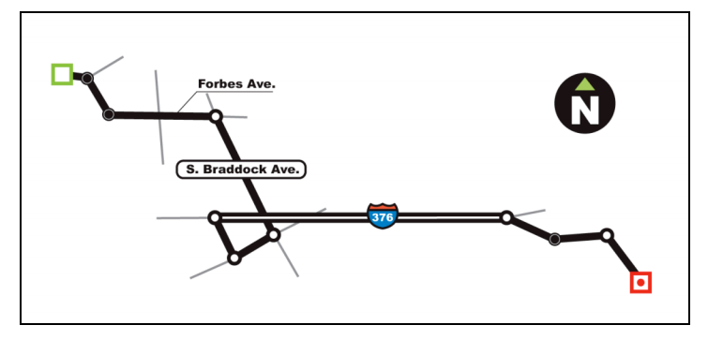
The Power of Design and interaction in Visualization
Lee, Forlizzi & Hudson

Slide 16
Planning a Visualization
What is its goal?
Does it use good design?
Have there been usability studies done? What do they show?

Slide 17
Holistic Design Goals for Information Visualization
Tailor to the application and the domain
Create highly interactive and integrated systems
Embed the visualization within a larger application
Provide alternative views

Slide 18
Two Different Primary Goals:
Explore/Calculate
Analyze
Reason about Information
Communicate
Explain
Make Decisions
Reason about Information

Slide 19
Two Different Sub-Goals:
Explore/Calculate
Analyze
Reason about Information
Communicate
Explain
Make Decisions
Reason about Information
Last Thursday’s class
Today’s class

Slide 20
Two Different Primary Goals:
Explore/Calculate
Analyze
Reason about Information
Communicate
Explain
Make Decisions
Reason about Information

Slide 21
Making Queries
Define the query[ies] you wish to support
“The special skill of designers … [is] the talent to analyze a design in terms of its ability to support the visual queries of others…”
Patterns ⬄ visual system
Cognitive process prediction
A continual fresh eye

Slide 22

Rzeszotarski & Kittur: Kinetica: Dynamic Exploration
Notes:
We found that physics-based interactions helped users explore multiple dimensions at once, make more descriptive and comparative findings about their data, and develop a more holistic understanding of a dataset. We invited 16 participants to use the software for 45 minutes in a lab study. As a comparison case, we also invited another group of 16 participants to follow the same study protocol using Excel rather than the application. Interestingly, Kinetica users made far more descriptive, comparative, and relationship findings than their Excel peers who almost always made point or statistical findings (Figure 7; c²(5)=31.3, p<0.001).

Slide 23
Two Different Sub-Goals:
Explore/Calculate
Analyze
Reason about Information
Communicate
Explain
Make Decisions
Reason about Information

Slide 24
Communication should:
Make large datasets coherent
Compact
Multivariate
Present information from various viewpoints
Support visual comparisons [Tufte]
Tell stories about the data (causality & structure...)
Have visual integration (images, words, etc.)
Document for credibility (baseline, scale, context)
Notes:
But remember “analytical presentations ultimately stand or fail depending on the quality, relevance, and integrity of their content” [Tufte, Beautiful Evidence, p. 136]

Slide 25
Planning a Visualization
What is its goal?
Does it use good design?
Does it account for human abilities
What are some compelling, useful examples? [COPY COPY COPY!]
How can we handle big data?
Have there been usability studies done? What do they show?
Notes:
(and do they match the goal?)

Slide 26
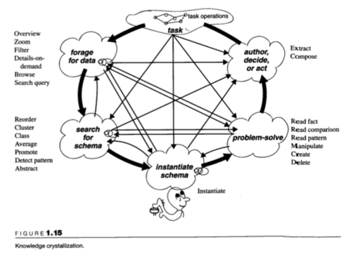
Supporting the Viewer
Overview
Zoom
Filter
Details-on-demand
Browse
Search query
Extract
Compose
Read fact
Read comparison
Read pattern
Manipulate
Create
Delete
Reorder
Cluster
Class
Average
Promote
Detect pattern
Abstract
Instantiate
Readings in Information Visualization: Using Vision to Think
edited by Stuart K. Card, Jock D. Mackinlay, Ben Shneiderman
Notes:
Different ways that visualizations could help amplify cognition: 1. By increasing memory and processing resources available 2. By reducing the amount of time to search 3. Enhancing the detections of patterns and enabling perceptual inference operations 4. Aid perceptual monitoring 5. By encoding information in a manipulable medium

Slide 27
What can people easily decode?
Ranked Order:
Position along a common scale (e.g., scatterplot)
Position along identical but non-aligned scales (e.g., table of scatter plots)
Length (e.g., bar chart)
Then angle & slope (pie chart); area (bubbles); volume/density/color (heatmap) and hue
William S. Cleveland and Robert McGill (1984) Graphical Perception: Theory, Experimentation, and Application to the Development of Graphical Methods (J. Am. Statistical Association)

Slide 28
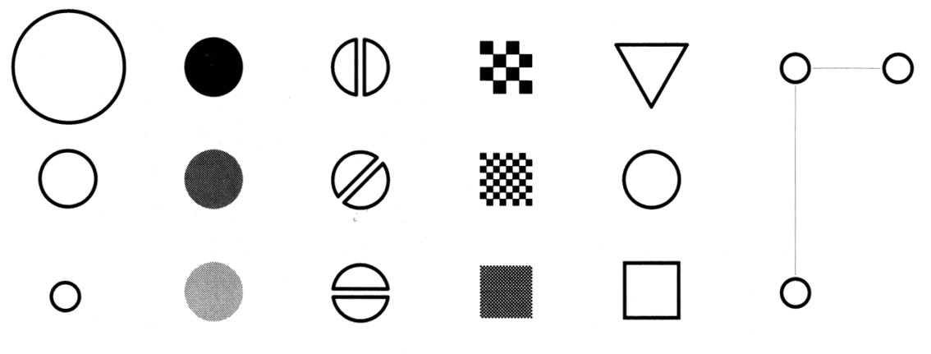
Making Things Distinct
Size
Value
Orientation
Texture
Shape
Position (2D / 3D)
Bertin’s ‘retinal variables’ form the basis for all forms of visual coding. A visual code can be based on (from left to right) contrasts of different types. Hue (chromatic color) provides an addition dimension not shown here.
Kevin Mullet and Darrell Sano, Designing Visual Interfaces
Slide from Marti Hearst/Jeff Heer via Jason Hong
Notes:
Note that while size and other cues provide for quantitative comparison, color (even luminance) only provides for ordering.
If the goal is contrast along any of these axes, make it distinct!

Slide 29
A summary of design elements
Use the eye for pattern recognition: people are good at
Scanning
Recognizing
Remembering images
What they do depends on their “visual query”
Tends to be “just in time”
Key graphical elements
Length
Shape
Orientation
Texture
Animation shows changes across time
Color helps make distinctions
Aesthetics make the process appealing

Slide 30
Planning a Visualization
What is its goal?
Does it use good design?
Does it account for human abilities
What are some compelling, useful examples? [COPY COPY COPY!]
Have there been usability studies done? What do they show?
Notes:
(and do they match the goal?)

Slide 31
Holistic Design Goals
Data & View Specifications | Visualize (choose encoding) Filter (focus on relevant items) Sort (expose patterns) Derive values or models
View Manipulation | Select (to highlight, filter, or manipulate) Navigate (zoom to examine patterns & detail) Coordinate (linked exploration) Organize windows and workspaces.
Process & Provenance | Record analysis histories Annotate patterns to document findings. Share views and annotations Guide users through analysis tasks or stories.
Heer & Shneiderman: Interactive Dynamics for Visual Analysis; ACM QUEUE, Feb 20, 2012
Notes:
Tailor to the application and the domain
Create highly interactive and integrated systems
Embed the visualization within a larger application
Provide alternative views

Slide 32
Holistic Design Goals
Data & View Specifications | Visualize (choose encoding) Filter (focus on relevant items) Sort (expose patterns) Derive values or models
View Manipulation | Select (to highlight, filter, or manipulate) Navigate (zoom to examine patterns & detail) Coordinate (linked exploration) Organize windows and workspaces.
Process & Provenance | Record analysis histories Annotate patterns to document findings. Share views and annotations Guide users through analysis tasks or stories.
Heer & Shneiderman: Interactive Dynamics for Visual Analysis; ACM QUEUE, Feb 20, 2012

Slide 33
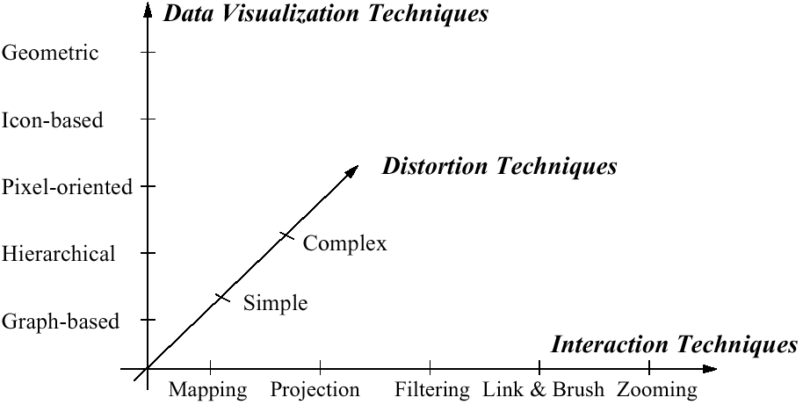
Visualization Techniques
http://www.visual-literacy.org/periodic_table/periodic_table.html
Notes:
nguyen

Slide 34
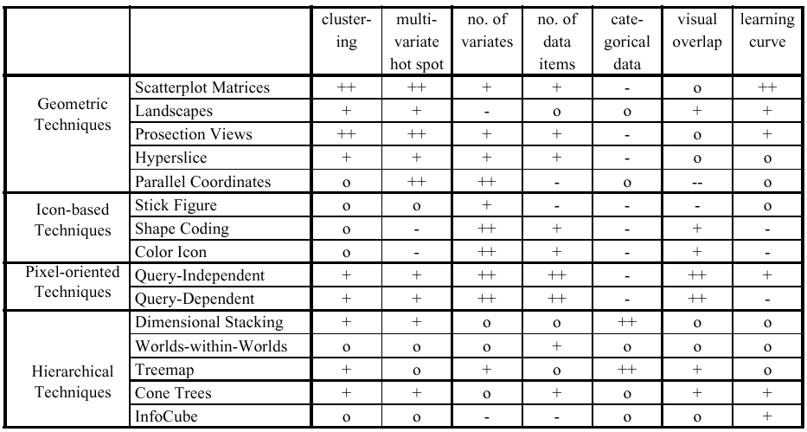
Comparison by Keim

Slide 35
Key Questions to Ask About a Visualization
What is its goal?
Does it use good design?
Have there been usability studies done? What do they show?
Notes:
(and do they match the goal?)

Slide 36
Does visualization help?
The jury is still out
Still supplemental at best for text collections
A correlation with spatial ability
Learning effects: with practice ability on visual display begins to equal that of text

Slide 37
The earth is getting warmer [which is closest to your view]: Create a viz
 | Sci. ‘14 | Sci. ‘09 | Aug 14 | Feb 14 | Oct 13 | Mar 13 | Oct 12 | Nov 11 | Feb 11 | Oct 10 | Sep 09 | April 09 | April 08 | Jan 07 | Aug 06 | Jul 06 | Jun 06
Mostly because of human activity | 87 | 84 | 50 | 40 | 44 | 42 | 42 | 38 | 36 | 34 | 36 | 49 | 47 | 47 | 47 | 50 | 41
Mostly because of natural patterns in the earth’s environment | 9 | 10 | 23 | 18 | 18 | 23 | 19 | 18 | 18 | 18 | 16 | 36 | 18 | 20 | 20 | 23 | 21
No solid evidence it is warming | 3 | 4 | 25 | 35 | 26 | 27 | 26 | 28 | 34 | 32 | 33 | 11 | 21 | 16 | 17 | 17 | 20
Don’t know/refused | 1 | 2 | 2 | 6 | 9 | 8 | 12 | 14 | 10 | 14 | 14 | 4 | 11 | 16 | 15 | 9 | 17

Slide 38
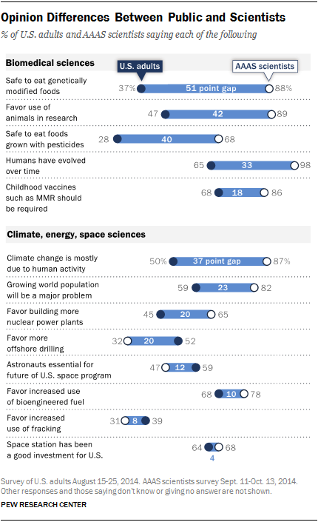
Notes:
Lightweight Visualization – what’s left out is as important as what is put in

Slide 39
Notes:
What’s even more important is what the ensured was included at the top and bottom…

